Slide 1

PowerPoint Slides prepared by:
Andreea CHIRITESCU
Eastern Illinois University
© 2015 Cengage Learning. All Rights Reserved. May not be copied, scanned, or duplicated, in whole or in part, except for use as permitted in a license distributed with a certain product or service or otherwise on a password-protected website for classroom use.

Slide 2
Ten Principles of Economics
© 2015 Cengage Learning. All Rights Reserved. May not be copied, scanned, or duplicated, in whole or in part, except for use as permitted in a license distributed with a certain product or service or otherwise on a password-protected website for classroom use.

Slide 3
Ten Principles of Economics
Economy, “oikonomos” (Greek)
  “One who manages a household”
  Households and economies have much in common
Households face many decisions
  Allocate scarce resources
    Ability, effort, and desire
Society faces many decisions
  Allocate resources and output
© 2015 Cengage Learning. All Rights Reserved. May not be copied, scanned, or duplicated, in whole or in part, except for use as permitted in a license distributed with a certain product or service or otherwise on a password-protected website for classroom use.

Slide 4
Ten Principles of Economics
Resources are scarce
Scarcity
  The limited nature of society’s resources
  Society has limited resources and therefore cannot produce all the goods and services people wish to have
Economics
  How society manages its scarce resources
  How people make decisions
© 2015 Cengage Learning. All Rights Reserved. May not be copied, scanned, or duplicated, in whole or in part, except for use as permitted in a license distributed with a certain product or service or otherwise on a password-protected website for classroom use.

Slide 5
Ten Principles of Economics
Economists study:
  How people make decisions
    Work, buy, save, invest
  How people interact with one another
  Analyze forces and trends that affect the economy as a whole
    Growth in average income
    Fraction of the population that cannot find work
    Rate at which prices are rising
© 2015 Cengage Learning. All Rights Reserved. May not be copied, scanned, or duplicated, in whole or in part, except for use as permitted in a license distributed with a certain product or service or otherwise on a password-protected website for classroom use.

Slide 6
Ten Principles of Economics
How people make decisions
  People face trade-offs
  The cost of something is what you give up to get it
  Rational people think at the margin
  People respond to incentives
© 2015 Cengage Learning. All Rights Reserved. May not be copied, scanned, or duplicated, in whole or in part, except for use as permitted in a license distributed with a certain product or service or otherwise on a password-protected website for classroom use.

Slide 7
Ten Principles of Economics
How people interact
  Trade can make everyone better off
  Markets are usually a good way to organize economic activity
  Governments can sometimes improve market outcomes
© 2015 Cengage Learning. All Rights Reserved. May not be copied, scanned, or duplicated, in whole or in part, except for use as permitted in a license distributed with a certain product or service or otherwise on a password-protected website for classroom use.

Slide 8
Ten Principles of Economics
How the economy as a whole works
  A country’s standard of living depends on its ability to produce goods and services
  Prices rise when the government prints too much money
  Society faces a short-run trade-off between inflation and unemployment
© 2015 Cengage Learning. All Rights Reserved. May not be copied, scanned, or duplicated, in whole or in part, except for use as permitted in a license distributed with a certain product or service or otherwise on a password-protected website for classroom use.

Slide 9
How People Make Decisions, #1
Principle 1: People face trade-offs
“There ain’t no such thing as a free lunch”
  To get something that we like, we usually have to give up something else that we also like
Making decisions
  Trade off one goal against another
© 2015 Cengage Learning. All Rights Reserved. May not be copied, scanned, or duplicated, in whole or in part, except for use as permitted in a license distributed with a certain product or service or otherwise on a password-protected website for classroom use.

Slide 10
How People Make Decisions, #1
Trade offs
  Students: time
  Parents: income
  Society
    National defense vs. consumer goods (guns vs. butter)
    Clean environment vs. high level of income
    Efficiency vs. equality
© 2015 Cengage Learning. All Rights Reserved. May not be copied, scanned, or duplicated, in whole or in part, except for use as permitted in a license distributed with a certain product or service or otherwise on a password-protected website for classroom use.

Slide 11
How People Make Decisions, #1
Efficiency
  Society getting the maximum benefits from its scarce resources
  Size of the economic pie
Equality
  Distributing economic prosperity uniformly among the members of society
  How the pie is divided into individual slices
© 2015 Cengage Learning. All Rights Reserved. May not be copied, scanned, or duplicated, in whole or in part, except for use as permitted in a license distributed with a certain product or service or otherwise on a password-protected website for classroom use.

Slide 12
How People Make Decisions, #2
Principle 2: The cost of something is what you give up to get it
People face trade-offs
  Make decisions
    Compare cost with benefits of alternatives
Opportunity cost
  Whatever must be given up to obtain some item
© 2015 Cengage Learning. All Rights Reserved. May not be copied, scanned, or duplicated, in whole or in part, except for use as permitted in a license distributed with a certain product or service or otherwise on a password-protected website for classroom use.

Slide 13
How People Make Decisions, #3
Principle 3: Rational people think at the margin
Rational people
  Systematically and purposefully do the best they can to achieve their objectives
Marginal changes
  Small incremental adjustments to a plan of action
© 2015 Cengage Learning. All Rights Reserved. May not be copied, scanned, or duplicated, in whole or in part, except for use as permitted in a license distributed with a certain product or service or otherwise on a password-protected website for classroom use.

Slide 14

How People Make Decisions, #3
Rational decision maker
  Make decisions by comparing marginal benefits and marginal costs
  Take action only if:
    Marginal benefits > Marginal costs
“Is the marginal benefit of this call greater than the marginal cost?”
© 2015 Cengage Learning. All Rights Reserved. May not be copied, scanned, or duplicated, in whole or in part, except for use as permitted in a license distributed with a certain product or service or otherwise on a password-protected website for classroom use.

Slide 15
How People Make Decisions, #4
Principle 4: People respond to incentives
Incentive
  Something that induces a person to act
  Higher price
    Buyers - consume less
    Sellers - produce more
  Public policy
    Change costs or benefits
    Change people’s behavior
© 2015 Cengage Learning. All Rights Reserved. May not be copied, scanned, or duplicated, in whole or in part, except for use as permitted in a license distributed with a certain product or service or otherwise on a password-protected website for classroom use.

Slide 16
The Incentive Effects of Gasoline Prices
2005 to 2008, price of oil in world oil markets skyrocketed
  Limited supplies
  Surging demand from robust world growth
  Price of gasoline in the United States rose from about $2 to about $4 a gallon
© 2015 Cengage Learning. All Rights Reserved. May not be copied, scanned, or duplicated, in whole or in part, except for use as permitted in a license distributed with a certain product or service or otherwise on a password-protected website for classroom use.

Slide 17
The Incentive Effects of Gasoline Prices
Increased incentive to conserve gas
  Smaller cars, scooters, bicycles, mass transit
  Camels (India)
  New, more fuel-efficient aircraft
    Airbus A320 and Boeing 737
  Moving near an Amtrak station
  Online courses
  Sean “Diddy” Combs - flying on commercial airlines
© 2015 Cengage Learning. All Rights Reserved. May not be copied, scanned, or duplicated, in whole or in part, except for use as permitted in a license distributed with a certain product or service or otherwise on a password-protected website for classroom use.

Slide 18
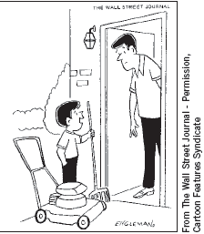
How People Interact, #5
Principle 5: Trade can make everyone better off
Trade
  Allows each person to specialize in the activities he or she does best
  Enjoy a greater variety of goods and services at lower cost
“For $5 a week you can watch baseball without being nagged to cut the grass!”
© 2015 Cengage Learning. All Rights Reserved. May not be copied, scanned, or duplicated, in whole or in part, except for use as permitted in a license distributed with a certain product or service or otherwise on a password-protected website for classroom use.

Slide 19
How People Interact, #6
Principle 6: Markets are usually a good way to organize economic activity
Communist countries, central planning
  Government officials (central planners)
    Allocate economy’s scarce resources
      What goods and services were produced
      How much was produced
      Who produced and consumed these goods and services
© 2015 Cengage Learning. All Rights Reserved. May not be copied, scanned, or duplicated, in whole or in part, except for use as permitted in a license distributed with a certain product or service or otherwise on a password-protected website for classroom use.

Slide 20
How People Interact, #6
Market economy, allocation of resources
  Through decentralized decisions of many firms and households
  As they interact in markets for goods and services
  Guided by prices and self-interest
© 2015 Cengage Learning. All Rights Reserved. May not be copied, scanned, or duplicated, in whole or in part, except for use as permitted in a license distributed with a certain product or service or otherwise on a password-protected website for classroom use.

Slide 21
How People Interact, #6
Adam Smith’s “invisible hand”
  Households and firms interacting in markets
    Act as if they are guided by an “invisible hand”
    Leads them to desirable market outcomes
  Corollary: Government intervention
    Prevents the invisible hand’s ability to coordinate the decisions of the households and firms that make up the economy
© 2015 Cengage Learning. All Rights Reserved. May not be copied, scanned, or duplicated, in whole or in part, except for use as permitted in a license distributed with a certain product or service or otherwise on a password-protected website for classroom use.

Slide 22
How People Interact, #7
Principle 7: Governments can sometimes improve market outcomes
We need government
  Enforce rules and maintain institutions that are key to a market economy
  Enforce property rights
  Promote efficiency, avoid market failure
  Promote equality, avoid disparities in economic wellbeing
© 2015 Cengage Learning. All Rights Reserved. May not be copied, scanned, or duplicated, in whole or in part, except for use as permitted in a license distributed with a certain product or service or otherwise on a password-protected website for classroom use.

Slide 23
How People Interact, #7
Property rights
  Ability of an individual to own and exercise control over scarce resources
Market failure
  Situation in which the market left on its own fails to allocate resources efficiently
  Externalities
  Market power
© 2015 Cengage Learning. All Rights Reserved. May not be copied, scanned, or duplicated, in whole or in part, except for use as permitted in a license distributed with a certain product or service or otherwise on a password-protected website for classroom use.

Slide 24
How People Interact, #7
Externality
  Impact of one person’s actions on the well-being of a bystander
  Pollution
Market power
  Ability of a single economic actor (or small group of actors) to have a substantial influence on market prices
© 2015 Cengage Learning. All Rights Reserved. May not be copied, scanned, or duplicated, in whole or in part, except for use as permitted in a license distributed with a certain product or service or otherwise on a password-protected website for classroom use.

Slide 25
How People Interact, #7
Disparities in economic wellbeing
  Market economy rewards people
    According to their ability to produce things that other people are willing to pay for
  Government intervention, public policies
    Aim to achieve a more equal distribution of economic well-being
    May diminish inequality
    Process far from perfect
© 2015 Cengage Learning. All Rights Reserved. May not be copied, scanned, or duplicated, in whole or in part, except for use as permitted in a license distributed with a certain product or service or otherwise on a password-protected website for classroom use.

Slide 26
How the Economy as a Whole Works, #8
Principle 8: A country’s standard of living depends on its ability to produce goods and services
Large differences in living standards
  Among countries
  Over time
Average annual income, 2011
  $48,000 (U.S.); $9,000 (Mexico)
  $5,000 (China); $1,200 (Nigeria)
© 2015 Cengage Learning. All Rights Reserved. May not be copied, scanned, or duplicated, in whole or in part, except for use as permitted in a license distributed with a certain product or service or otherwise on a password-protected website for classroom use.

Slide 27
How the Economy as a Whole Works, #8
Explanation: differences in productivity
Productivity
  Quantity of goods and services produced from each unit of labor input
  Higher productivity
    Higher standard of living
  Growth rate of nation’s productivity
    Determines growth rate of its average income
© 2015 Cengage Learning. All Rights Reserved. May not be copied, scanned, or duplicated, in whole or in part, except for use as permitted in a license distributed with a certain product or service or otherwise on a password-protected website for classroom use.

Slide 28
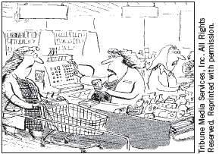
How the Economy as a Whole Works, #9
Principle 9: Prices rise when the government prints too much money
Inflation
  An increase in the overall level of prices in the economy
Causes for large or persistent inflation
  Growth in quantity of money
      Value of money falls
“Well it may have been 68 cents when you got in line, but it’s 74 cents now!”
© 2015 Cengage Learning. All Rights Reserved. May not be copied, scanned, or duplicated, in whole or in part, except for use as permitted in a license distributed with a certain product or service or otherwise on a password-protected website for classroom use.

Slide 29
How the Economy as a Whole Works, #10
Principle 10: Society faces a short-run trade-off between inflation and unemployment
Short-run effects of monetary injections:
  Stimulates the overall level of spending
    Higher demand for goods and services
  Firms – raise prices; hire more workers; produce more goods and services
  Lower unemployment
© 2015 Cengage Learning. All Rights Reserved. May not be copied, scanned, or duplicated, in whole or in part, except for use as permitted in a license distributed with a certain product or service or otherwise on a password-protected website for classroom use.

Slide 30
How the Economy as a Whole Works, #10
Short-run trade-off between unemployment and inflation
  Key role – analysis of business cycle
Business cycle
  Fluctuations in economic activity
    Employment
    Production
© 2015 Cengage Learning. All Rights Reserved. May not be copied, scanned, or duplicated, in whole or in part, except for use as permitted in a license distributed with a certain product or service or otherwise on a password-protected website for classroom use.

Slide 31
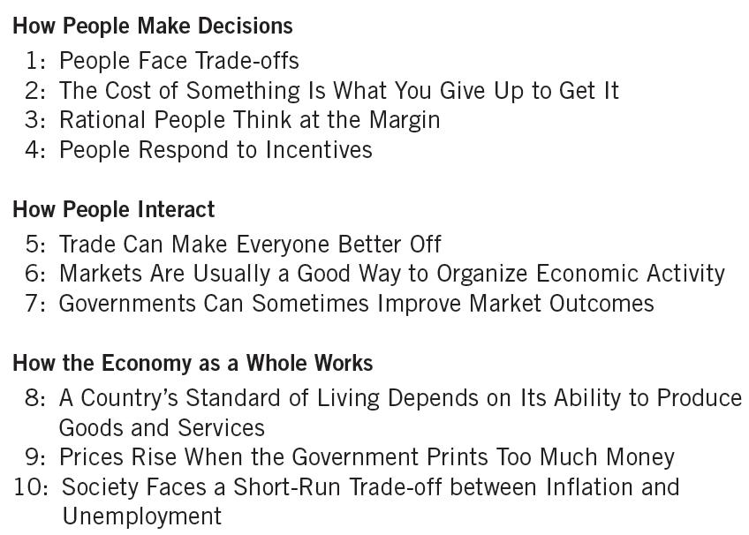
Table 1
Ten Principles of Economics
© 2015 Cengage Learning. All Rights Reserved. May not be copied, scanned, or duplicated, in whole or in part, except for use as permitted in a license distributed with a certain product or service or otherwise on a password-protected website for classroom use.

